Slide 1
Fiscal 2018
1st Quarter Projections
Department of Finance | Report to City Council
November 14, 2017

Slide 2
Overview
Fiscal 2017 Close Out
Fiscal 2018 1st Quarter Projection

Slide 3
Fiscal 2017 Close Out

Slide 4
General Fund Summary
FISCAL 2017 – PRELIMINARY CLOSE OUT
 | Adopted Budget | Preliminary Projection | Surplus/ (Deficit)
Revenue | 1,762.8 | 1,797.9 | 35.1
PAYGO Capital | 15.5 | 15.5 | 0.0
Expenditures | 1,747.3 | 1,742.5 | 4.8
Surplus/(Deficit) | 0.0 | 39.9 | 39.9

Slide 5
Revenue Summary
$35M Revenue Surplus vs. Adopted Budget
Includes $9.3M in revenue from one-time sources:
$6M FEMA snow storm reimbursement
$2M BSO payment of outstanding loan
$1.3M Legg Mason profit sharing agreement
Recurring revenue surplus of $25.7M or 1.5% of the Adopted Budget

Slide 6
Revenue Summary
Major Drivers of Surplus
Income Tax:
$17.5M surplus vs. budget
Fiscal 2017 budgeted revenue aligned with historic trends in the City’s income growth
Growth is now catching up to the state
Transfer & Recordation Taxes:
$25.9M surplus vs. budget
Highly sensitive to housing market activity
Budgeted at 5 year average to smooth abrupt increases/decreases

Slide 7
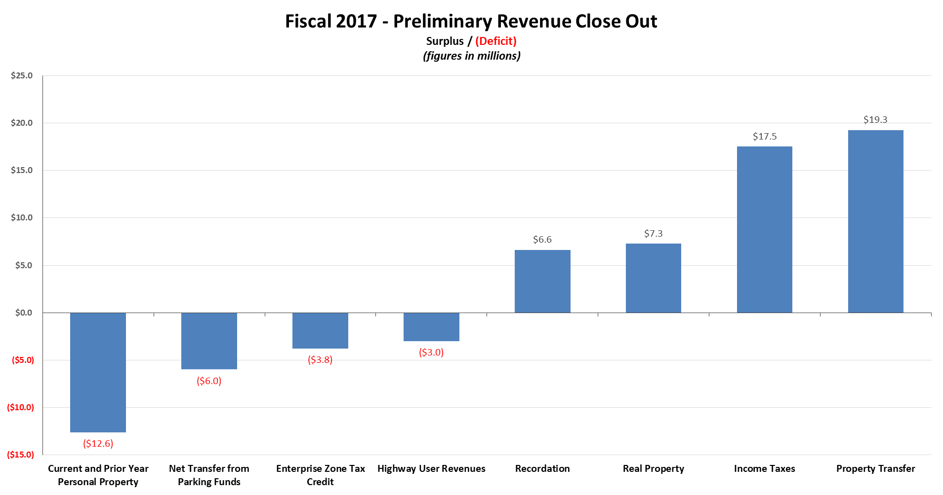
Major Revenues

Slide 8
Expenditure Summary
$5M Expenditure Surplus vs. Adopted Budget
Surplus in Debt Service due to project timing and payment schedules
Deficits in Fire and Police for overtime
All other agency surpluses netted $6.7M which represents only 0.4% of Adopted Budget

Slide 9
Changes vs. 3rd Quarter
Fiscal 2017 | 3rd QUARTER |  |  | PRELIMINARY CLOSE OUT
 | Adopted Budget | 3rd Quarter Projection | Surplus/ (Deficit) | Adopted Budget | Preliminary Projection | Surplus/ (Deficit)
Revenue | 1,762.8 | 1,770.3 | 7.5 | 1,762.8 | 1,797.9 | 35.1
PAYGO Capital | 15.5 | 15.5 | 0.0 | 15.5 | 15.5 | 0.0
Expenditures | 1,747.3 | 1,742.8 | 4.5 | 1,747.3 | 1,742.5 | 4.8
Surplus/(Deficit) | 0.0 | 12.0 | 12.0 | 0.0 | 39.9 | 39.9

Slide 10
Fund Balance
Fiscal 2017 CAFR Assignments | 3rd Quarter Reported | Preliminary Close Out
Fire & Police pension litigation | 50.0 | 24.3
BCPS surplus schools | 17.6 | 0.0
BCPS operating support | 30.0 | 48.0
Department of Justice review | 2.5 | 2.5
Total | 100.1 | 74.8

Slide 11
Fiscal 2018 1st Quarter Projections

Slide 12
General Fund Summary
FISCAL 2018 – 1st QUARTER PROJECTION
 | Adopted Budget | Budget Adjustments | Adjusted Budget | 1st Qtr Projection | Surplus/ (Deficit)
Revenue | 1,834.9 | 3.6 | 1,838.5 | 1,874.0 | 35.5
PAYGO Capital | 21.4 | 0.0 | 21.4 | 21.4 | 0.0
Expenditures | 1,813.5 | 3.6 | 1,817.1 | 1,816.6 | 0.5
Surplus / (Deficit) | 0.0 |  | 0.0 | 36.0 | 36.0

Slide 13
Revenue Summary
$35.5M Revenue Surplus vs. Adjusted Budget
Includes $41.6M in revenue from volatile sources
$8M projected deficit in Income tax due to overpayment in prior years
All other revenues net of Transfer & Recordation, Speed & Red Light violations, and Income Tax sum to a $2M surplus
Overall revenue surplus of $35.5M is 1.9% of the Adjusted Budget

Slide 14
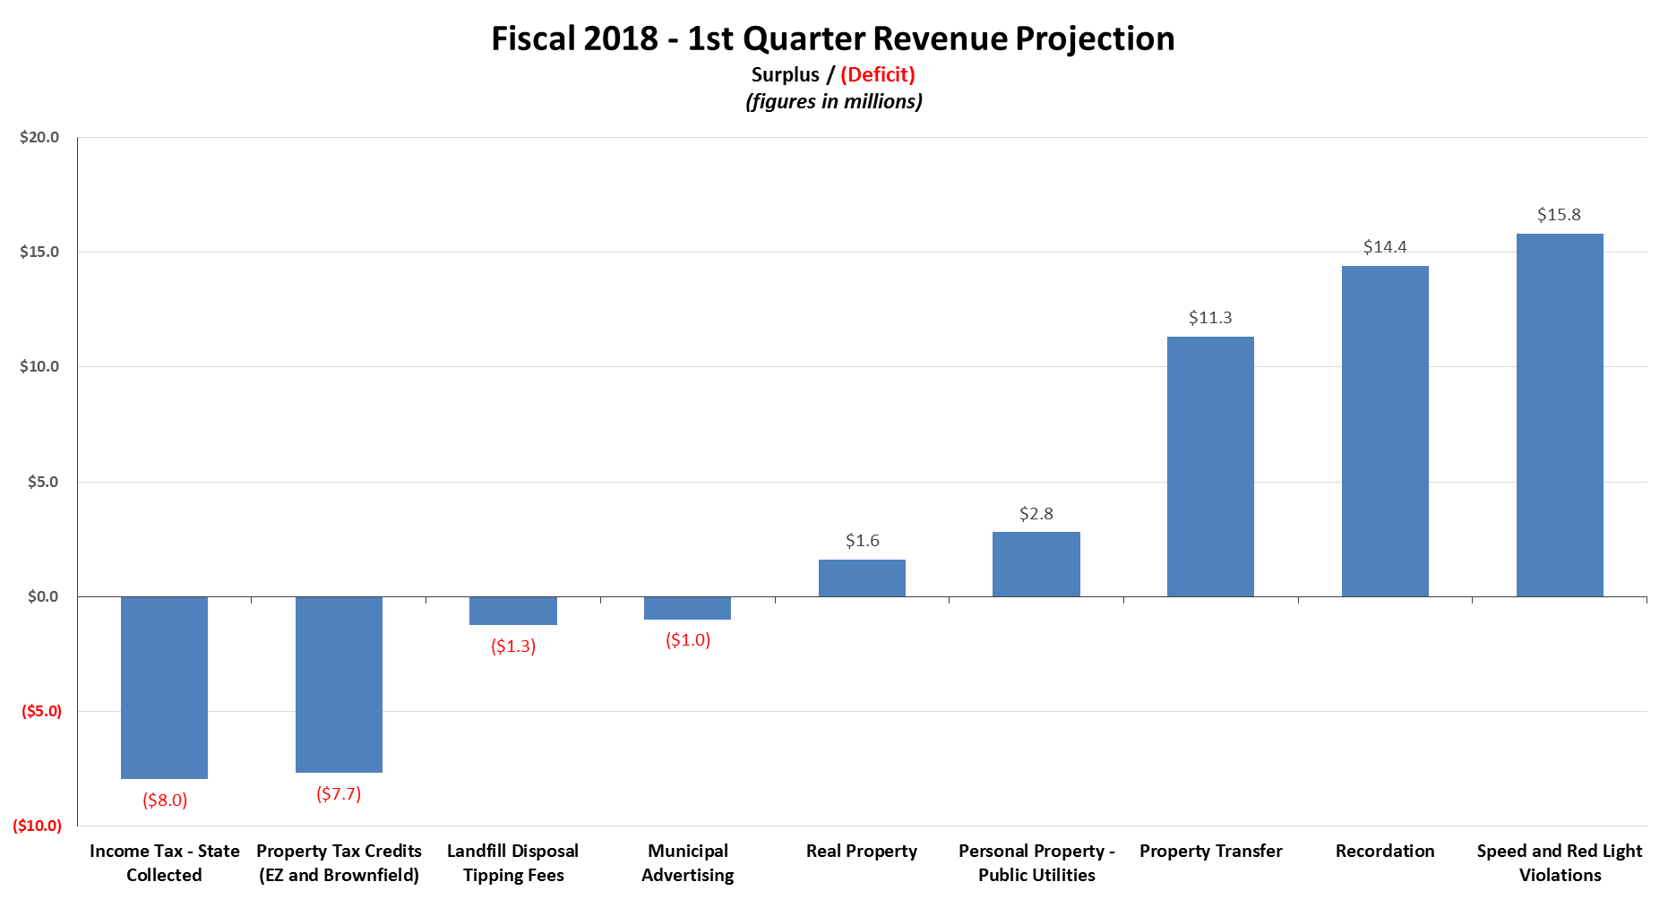
Major Revenues

Slide 15
Expenditure Summary
$0.5M Expenditure Surplus vs. Adjusted Budget
$11.7M surplus in Debt Service due to project timing and payment schedules
Deficits in Fire ($3.8M) and Police ($17.6M) for overtime
Overall expenditure surplus represents a very thin margin; only 0.03% of Adjusted Budget

Slide 16
Final Summary
Overall General Fund surplus of $36M
Surplus is largely driven by two highly volatile/sensitive sources:
Transfer & Recordation ($25.7M)
Traffic Cameras ($15.9M)
Surplus from these sources should be earmarked for PAYGO capital and/or assigned fund balance.

Slide 17
Questions?

